Slide 1
API Gateway ---Lab Setup

Slide 2
Outline
Objectives
On completing this module, you will be able to:
Understand the uses of an API Gateway Kong in an enterprise solution
Topics
API Gateway
Kong

Slide 3
Functionalities and Benefits of API Gateway
API Gateway, as a central hub, helps to decouple the clients and the (micro)service providers.
It can also implement many functionalities commonly needed for all the service providers.
(Re-)Routing of communication data
Load balancing
Security enforcement (e.g., access control)
Monitoring / logging
Caching
Versioning
Aggregation
……

Slide 4

Example: Microservice Interaction Diagram – Browse books in our bookstore scenario
Book
1. Get all books
2. Return a list of books
Amazing Bookstore UI
Browse books
Legend
Micro-service
External service

Slide 5
Kong for Service Routing
Configurations
A service in Kong: an abstract representation of an upstream service to be invoked.
A service route: a mapping from the URL of client requests to the URL of an upstream service
http://book1:5000/book
Kong
container
Book container 1
Docker Engine
create a private network to be shared among all the containers
bind localhost:8000 to kong:8000
Request for
http://localhost:8000/api/v1/book
Amazing Bookstore UI
Browse books
Notes:
An API gateway can route a request from an external client to an internal/upstream (micro)service.
The URLs used by the client and the actual URL of the microservice can be different; the gateway is responsible for the translation (so called routing).
We'll be using the Kong API gateway from within a container.
By default, Kong uses port 8000 to accept HTTP requests;
So, we need to expose the Kong container's 8000 port to the external network for clients to use.
Inside the gateway,
A service (may also be called gateway service) in Kong is set up to store the URL/path (http://book1:5000/book in this case) of the book microservice to be invoked;
The actual (micro)service to be invoked is called an upstream service in Kong; it is called an "upstream" service since it is located relatively in the upstream in the call chains from the relatively downstream client;
A route in Kong is also part of the configurations for a service in Kong; it is set up to map the URL/path from a client request to the upstream service URL;
Its functionality is like an app.route annotation in a python flask program that maps a URL/path to a python function.
In this case, the client can use /api/v1/book to invoke the book microservice via Kong; Kong receives the request and maps "/api/v1/book" to "http://book1:5000/book" for the request
Each service in Kong can have more than one route.
A service in Kong doesn't perform actual business functionality; it only does translation of the URLs;
It is just like a wrapper or a storage box that stores an interface to the upstream services.
An upstream service can be a service that performs actual business functionality (e.g., the book microservice in this case), or another external service (e.g., a Google service), or another service inside Kong---in which case, the upstream service is "virtual", not doing actual business functionality, but just doing another layer of routing.

Slide 6
Kong for Service Load Balancing
http://book1:5000/book
http://book2:5000/book
Kong
container
Configurations additional in Kong:
A virtual upstream: a virtual hostname referring to the host(s) of the target service to be load-balanced
Book container 1
Book container 2
Load Balancing
Docker Engine
create a private network to be shared among all the containers
bind localhost:8000 to kong:8000
Request for
http://localhost:8000/api/v1/book
Amazing Bookstore UI
Browse books
Notes:
In addition to a service and a route settings,
A virtual hostname (called an "upstream") in Kong will be created;
The upstream will be set to have references to two or more hosts of the same actual service to be load-balanced; in this case, the hosts are book1:5000 and book2:5000 for the book microservice; those hosts running the actual service are called targets in Kong. If there is only one target, it will behave like a normal route without load balancing effect.
The service (may also be called gateway service) in Kong needs to be changed to use this newly created upstream in its upstream service URL, so that the route will map the URL/path from client requests to the upstream;
The upstream will then distribute incoming client requests to the targets according to certain load-balancing rules.

Slide 7
Docker Compose for Service Load Balancing
Book container 1
Book container 2
Configurations
A service in Kong: an abstract representation of an upstream service to be invoked.
A service route: a mapping from the URL of client requests to the URL of an upstream service
Load Balancing
Kong
container
Load Balancing
Book with 2 replicas
Docker Compose
Docker Engine
create a private network to be shared among all the containers
bind localhost:8000 to kong:8000
Request for
http://localhost:8000/api/v1/book
Amazing Bookstore UI
Browse books
Notes:
Use docker compose to auto create and manage 2 instances (so called replicas) of the Book service:
Option 1: run the command:
docker compose up -d book --scale book=2
Option 2: define replicas in compose.yaml file:
…
book:
…
deploy:
replicas: 2

Slide 8
Kong for API-Key Based Authentication & Authorization
Configurations additional in Kong:
A consumer: an account representing a client/user of the target service(s).
A consumer group: a group of consumers.
An API key for a consumer: a kind of credentials for the consumer.
An access-control list (ACL): a list of permissions, defining which consumer groups can/cannot access which services or service routes.
http://book1:5000/book
http://book2:5000/book
Kong
container
Book container 1
Book container 2
API-Key-Auth
Docker Engine
create a private network to be shared among all the containers
bind localhost:8000 to kong:8000
Request for
http://localhost:8000/api/v1/book
Amazing Bookstore UI
Browse books
Notes:
In addition to previous settings,
Need to set up consumer accounts and their permissions (ACL) in Kong for access control.

Slide 9
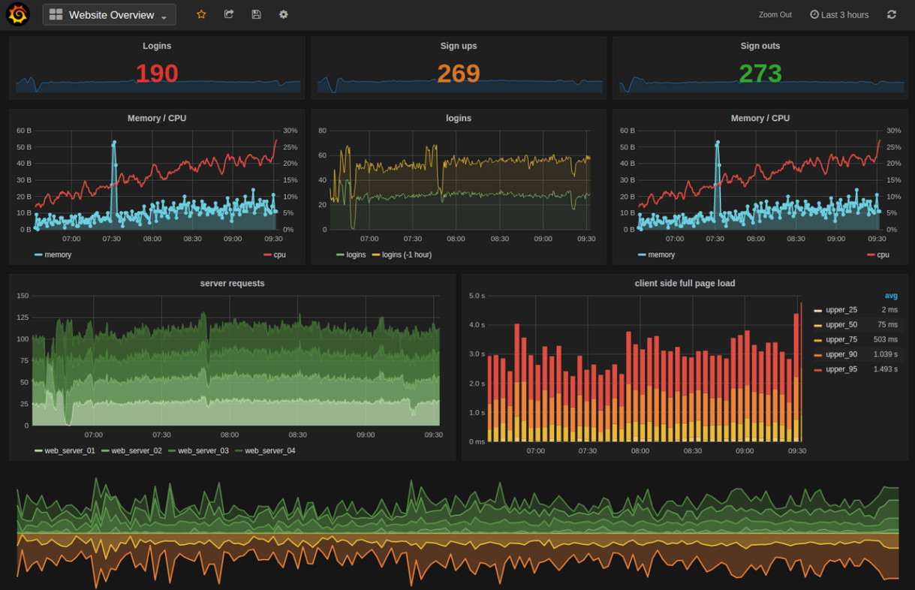
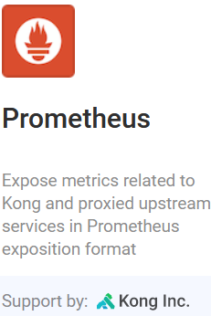

Kong for API Monitoring
http://book1:5000/book
http://book2:5000/book
Kong
container
Book container 1
Book container 2
Docker Engine
create a private network to be shared among all the containers
bind localhost:8000 to kong:8000
Request for
http://localhost:8000/api/v1/book
Amazing Bookstore UI
Browse books
Notes:
Kong Admin APIs for measurements can be exposed via its port 8001 by default.
The Prometheus plugin of Kong exposes all the measurements/metrics/logs to a Prometheus server which records them in a time series database (allowing for high dimensionality and flexible and efficient queries).
The Prometheus server exposes its data via its port 9090 by default.
The Grafana server connects to the Prometheus server to retrieve and construct various kinds of visualization of the data.
A dashboard can be connected to the Grafana server via its default port 3000, to display the visualized data for human analyzers.

Slide 10




Software Setup Overview
Book container 1
Book container 2
Kong
container
PostgreSQL
DB container
book.py
book.py
Libs
Libs
CMD:
docker pull
docker run
docker stop
docker start
……
Docker Client
Book DB
Docker Engine
create a private network to be shared among all the containers
bind localhost:8000 to kong:8000
bind localhost:8002 to kong:8002 and others
bind localhost:9090 to prometheus:9090 and localhost:13000 to grafana:3000
MySQL DB in
WampServer
Docker Host
(e.g., a Windows OS)
File systems
a.k.a. volumes in Linux terminology.
Used for persistent and shared storages across containers
Web Browser / Postman:
Amazing Bookstore UI
Browse books
Add a book
Web Browser:
Kong Manager GUI
Administrate Kong
Web Browser:
Prometheus GUI
Grafana GUI
Notes:
For clients invoking the Book microservice:
An external client can access the Book microservice via the Kong API Gateway in a web browser or Postman.
Multiple containers for the Book microservices can run on the Docker Engine and share the same Book database on the Docker Host.
These containers don't need to expose their internal ports/urls to the external clients because they will be created in the same internal network.
The Kong API gateway manages the client's requests to all the containers for the Book microservice.
For administrating Kong:
The Kong API gateway provides RESTful admin APIs for programmatically control of the gateway, which are via port 8001 by default;
Kong Manager provides web GUIs (via port 8002 by default) for an admin person to configure the Kong gateway.
The configurations set in Kong can be stored in a database (e.g., a PostgreSQL database container) and/or in the file system on the Docker Host. A file system is also known as a volume in Linux terminology.
Kong is installed and running in a container in the same internal network created by the Docker Engine; so, we need to expose its internal ports (e.g., 8000) for external clients to access.
An admin can also manage all the containers using a Docker client (e.g., a cmd windows) on the Docker Host.

Slide 11
Software Setup Overview w/ Docker Compose
Book container 1
Book container 2
Kong
container
PostgreSQL
DB container
book.py
book.py
Docker Compose
Docker Compose
Docker Compose
Libs
Libs
CMD:
docker pull
docker run
docker stop
docker start
……
Docker Client
Book DB
Docker Engine
create a private network to be shared among all the containers
bind localhost:8000 to kong:8000
bind localhost:8002 to kong:8002 and others
bind localhost:9090 to prometheus:9090 and localhost:13000 to grafana:3000
MySQL DB in
WampServer
Docker Host
(e.g., a Windows OS)
File systems
a.k.a. volumes in Linux terminology.
Used for persistent and shared storages across containers
Web Browser / Postman:
Amazing Bookstore UI
Browse books
Add a book
Web Browser:
Kong Manager GUI
Administrate Kong
Web Browser:
Prometheus GUI
Grafana GUI
Notes:
For clients invoking the Book microservice:
An external client can access the Book microservice via the Kong API Gateway in a web browser or Postman.
Multiple containers for the Book microservices can run on the Docker Engine and share the same Book database on the Docker Host.
These containers don't need to expose their internal ports/urls to the external clients because they will be created in the same internal network.
The Kong API gateway manages the client's requests to all the containers for the Book microservice.
For administrating Kong:
The Kong API gateway provides RESTful admin APIs for programmatically control of the gateway, which are via port 8001 by default;
Kong Manager provides web GUIs (via port 8002 by default) for an admin person to configure the Kong gateway.
The configurations set in Kong can be stored in a database (e.g., a PostgreSQL database container) and/or in the file system on the Docker Host. A file system is also known as a volume in Linux terminology.
Kong is installed and running in a container in the same internal network created by the Docker Engine; so, we need to expose its internal ports (e.g., 8000) for external clients to access.
An admin can also manage all the containers using a Docker client (e.g., a cmd windows) on the Docker Host.

